Slide 1
Family FOS Presenter Training
Thank you for volunteering
for the 2019 FOS Campaign

Slide 2
Introductions and Structure
Council FOS Chair
Keith Ross
North Star
Joe Rada
Aptakisic
Jonathan Grote
Potawatomi
John Phelan

Slide 3
Professional Staff
 | Staff | Phone/Text | E-mail
Potawatomi | Emily Prymula | 847.527.9629 | Emily.Prymula@scouting.org
Aptakisic | Zach Knoch | 224.727.2202 | Zachary.Knoch@scouting.org
North Star | Nicole Karlove | 847.527.9635 | Nicole.Karlove@scouting.org
NEIC | Cynthia Gentleman | 224.727.2483 | Cynthia.Gentleman@scouting.org

Slide 4
NEIC Expenses

Slide 5
Program Support
Recruitment
Training
New Scout Store
Professional and support Staff
Volunteer Coaching
Strategic Planning
Website
Kasperson Center for Scouting at Morrison
Three Camps
Record Keeping
Insurance Coverage
Volunteer Recruitment Support
Unit Program Planning
Program Incentives

Slide 6
Funding the NEIC

Slide 7
2019 FOS Goals - $713,000
District | Family | Matching | Community | Totals
PW | $192,000 | $3,000 | $20,000 | $215,000
AP | $143,000 | $10,000 | $18,000 | $171,000
NS | $170,000 | $15,000 | $13,000 | $198,000
Board |  |  |  | $129,000

Slide 8
FOS Structure
2018
2019
NEIC FOS
Board
District Campaigns
Board Members
Advisory Board
Friends of the Board
Family
Community
Leadership
Matching
NEIC FOS
Board
District Campaigns
Board Members
Advisory Board
Friends of the Board
Family
Community
Matching

Slide 9
Unit Goals and Incentives
Pack Average Gift Per Scout
District | Previous years Average | 2019 Goal
Aptakisic | $19 | $20
North Star | $57 | $57
Potawatomi | $33 | $35
Troop Average Gift Per Scout
District | Previous years Average | 2019 Goal
Aptakisic | $117 | $120
North Star | $111 | $115
Potawatomi | $166 | $166

Slide 10
Unit Goals - Recognition
Level | Deadline | Scout Bucks | Free Rank until May 15, 2020
Gold | Day of OR unit with a goal exceeding $8,000 raises its goal by May 1st | 5% | Y
Silver | Unit raises goal within 30 days of presentation | 3% | Y
Bronze | Unit raises goal by April 30, 2019 |  | Y

Slide 11
The Process
Days Out | Action | Responsible
-14 | Unit Coordinator & Presenter Intro/Goal Email | District
-7 | Unit Coordinator sends out pre presentation email | Unit Coordinator
0 | Presentation Day | Unit Coordinator/ Presenter
0-1 | Report your presentation results to District Professional | Presenter
+1-2 | Return kit to NEIC | Presenter
+2 | Unit Coordinator sends out post presentation email | Unit Coordinator
+5 | Thank you for participating in FOS email to whole unit | Council
+7 | Status to goal update | District
+15 | 30 days to goal email | District
? | Congratulations email | Council

Slide 12
Day of Presentation
Arrive 15 minutes early, full uniform
Make Presentation early in program
Collect Pledges
Report back to the unit with leads to follow up on
Report that night’s results to district professional by text or email within 24 hours
Please plan on staying for the whole event

Slide 13
Donor Recognition Levels
Gift Level | Thank You Items
$1 - $191 | 2019 Square Button Loop Patch
$192 - $383 | Red Council Strip
$384 - $499 | Ma-Ka-Ja-Wan 90th Anniversary Lantern & Red Council Strip
$500 – Above | Ghost Council Strip Patch & Lantern

Slide 14
Presentation Logistics
Remember that you are making this presentation to provide everyone with the opportunity to participate in the Scouting program.
Have pledge envelopes and samples of recognition items with you as you speak for reference.
The body of your presentation needs to be from the heart. Practice if necessary!

Slide 15
FOS Presentation Recipe
Step 1: The Introduction
Ask the Unit Leader to give a public gift
Introduce yourself as a volunteer or parent of x number of scouts
Thank the parents and volunteers for participating in scouting
Step 2: What is Friends of Scouting
Once a year opportunity to support the Northeast Illinois Council
Friends of Scouting campaign raises a fourth of the council budget and allows us to keep scouting local and accessible
Step 3: What does the Scouting Provide
Tell your story
Memories at our council camps and events. Talk about what the unit participates in
Introduce our New and improving facilities (Kasperson Center & Cabin)
Step 4: The Ask
“Your gift helps create better young people, better citizens and a better Nation. Please consider a gift of $384 to help support scouting in the Northeast Illinois Council. Any gift you can give to help support our mission is greatly appreciated.”
Please use this language

Slide 16
Let’s Practice!
Pick a buddy
Practice your presentation

Slide 17
Presentation Logistics Cont.
If you can, use our Friends of Scouting Video as a tool in your presentation.
Stress that this is a pledge envelope and that if they want to pay later, all they need to do is put the total gift and how they want to be invoiced.

Slide 18
Credit Card Donations
One time Credit Card donations can be made using Text to Give. Supporters wanting to make installments on a credit card will need to mark it on the form and they will be contacted for their credit card information.

Slide 19
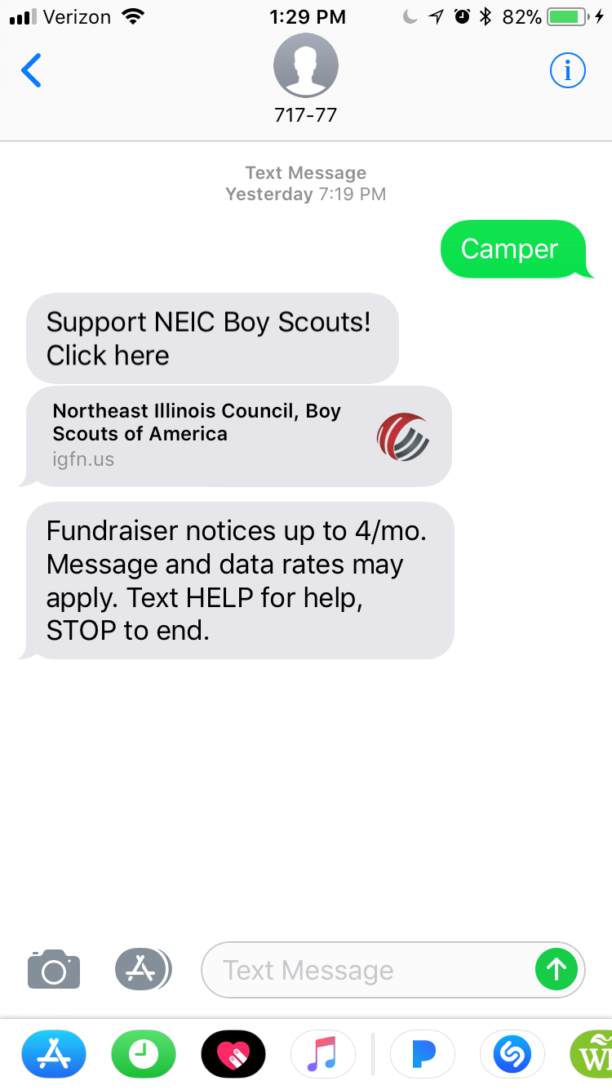
Text to Give – for one time online donations
The unit will receive a unique code for their giving site
The individual will receive four reminder texts if they don’t complete the process

Slide 20
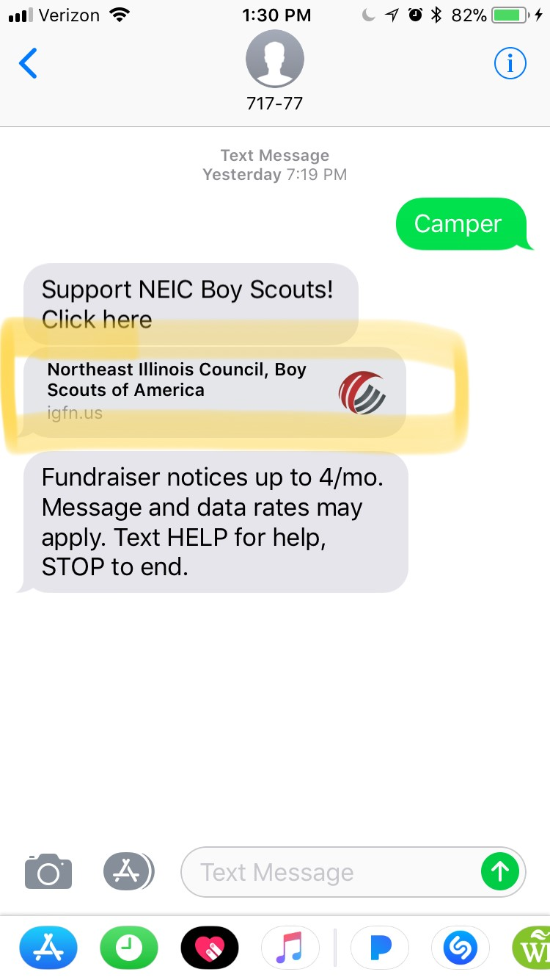
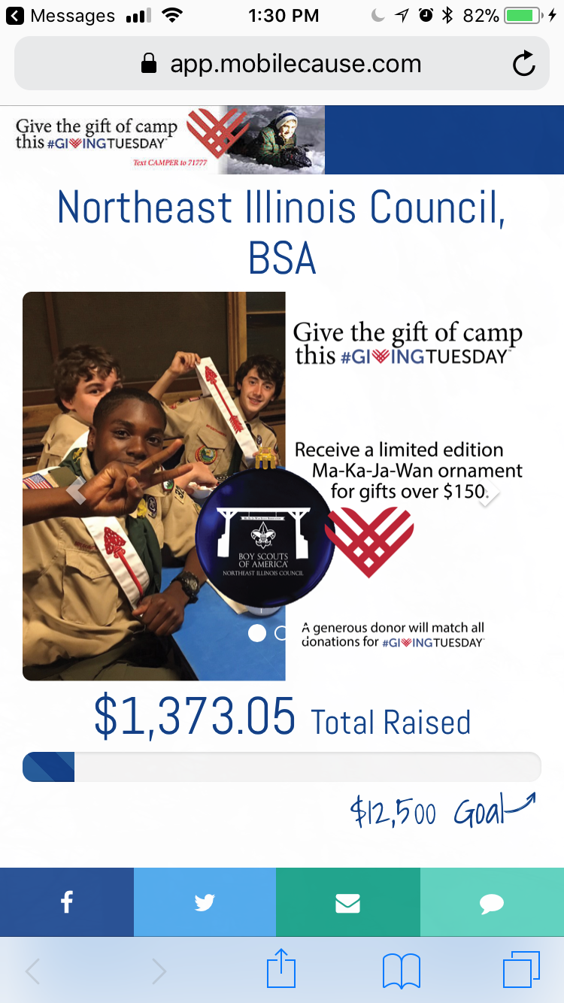
Text to Give – for one time online

Slide 21
Text to Give What has changed
MobileCause will only serve as a credit card transaction site. Units will NOT be able to track their goal progress this way.
Units will now receive their FOS reports from the district teams.

Slide 22
Matching Gifts – neic.org/match
Every supporter needs to receive a matching gift reminder card, located on the back of the Text to Give cards.
This card drives them to
neic.org/match, which provides a search engine to find the matching process.

Slide 23
Step for Success
Sign up early and hold presentation before April 15
Give presentation early in the evening
Have a dedicated unit coordinator that will introduce the presenter, give a lead gift, and follow up after the presentation
Update the goal throughout the presentation

Slide 24
What is in the Kit
Pens
Audit Report
Empty Return Envelopes
Patches
Participation Patches
Orange Council Strip
Ghost Council Strip
Presenter Guide and Recipe
Blank FOS Pledge Envelopes
Text to Give/Matching Gift Cards

Slide 25
FOS Recognition Events
January 17th @ 6:30 pm
Dave & Buster’s Vernon Hills
March 21st @ 6:30 pm
May 16th @ 6:30 pm

