Slide 1
SCOUTS BSA
JOIN NIGHT
Troop ______
______ District
Northeast Illinois Council, BSA
Notes:
Make sure to introduce yourself before you get started! Who are you? What’s your role? Etc.

Slide 2
WELCOME TO SCOUTS BSA!
Notes:
Don’t overlook this slide, it’s important to make people feel welcome! Many of the people at this join night may have no connection to Scouting, so take extra care to make them feel welcome. This may feel like old news for some of the lifetime Scouts, but they’re already bought in so spend your time working on welcoming the potential new Scouts.

Slide 3
In short…
YOUR KIDS ARE GOING TO LOVE THIS!
Notes:
This is the most important slide. If there is one thing you can instill in parents and kids who are in this meeting it is this slide. Sure, we want to (and need to) talk about character development, leadership training, etc., etc., but if parents and kids don’t see the fun side they’re not going to sign up. Customize this deck however you want to, but leave this one slide in.

Slide 4
SO, WHAT IS SCOUTS BSA?
Notes:
This is why we’re all here, so lead with this. Keep it simple.

Slide 5
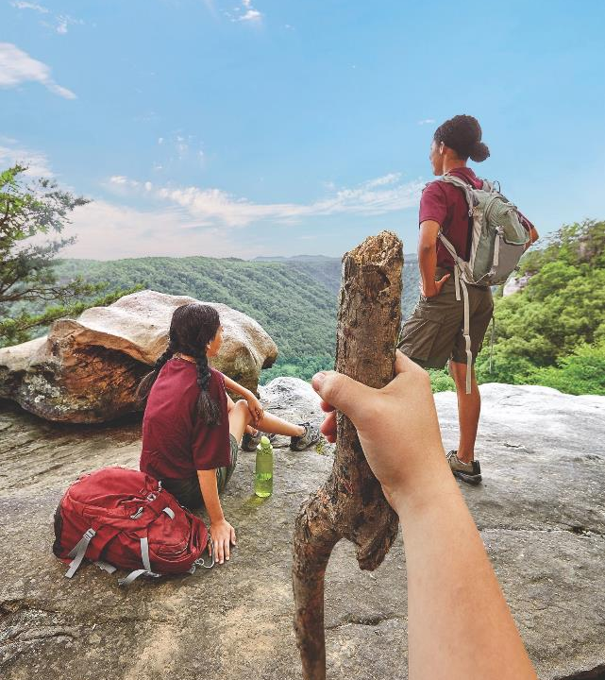
Scouts BSA is the Boy Scouts of America’s
iconic program, now open to boys and girls.
Notes:
It’s important to emphasize that this is the same program kids have been participating in for years. The curriculum didn’t change, it’s simple open to everyone now. We will continue to develop strong young leaders who will be the future of the next generation of great Americans, just as they always have. The only change is that now girls can participate too.

Slide 6
SCOUTS BSA
SLIDE SUB-TITLE
OVERVIEW
For the first time in our 100+ year history, boys and girls will have the chance to work toward the BSA’s most prestigious award, the rank of Eagle Scout!
Notes:
Our research shows that most people in the United States know what the Boy Scouts are and know what Eagle Scouts are. While they may not know the details, the name Eagle Scout means something and is especially important to the next generation of young Scouts who are looking to make their mark. Don’t shy away from talking about this, but don’t worry too much about what the various ranks are just yet, we’ll get there later.

Slide 7
OUR GUIDING PRINCIPLES
Notes:
These are the principles that define who we are as an organization and will help us to provide guidance to the youth in our programs. They have stood the test of time and will continue to provide guidance for us and for the youth we serve for generations to come.

Slide 8
MISSION STATEMENT
The mission of the Boy Scouts of America is to
prepare young people to make ethical and moral
choices over their lifetimes by instilling in them
the values of the Scout Oath and Law.
Notes:
This message is one parents want to hear. At the end of the day, we want them to feel comfortable enrolling their kids in our programs where they know they are receiving the type of education and training to help them become the best version of themselves.

Slide 9
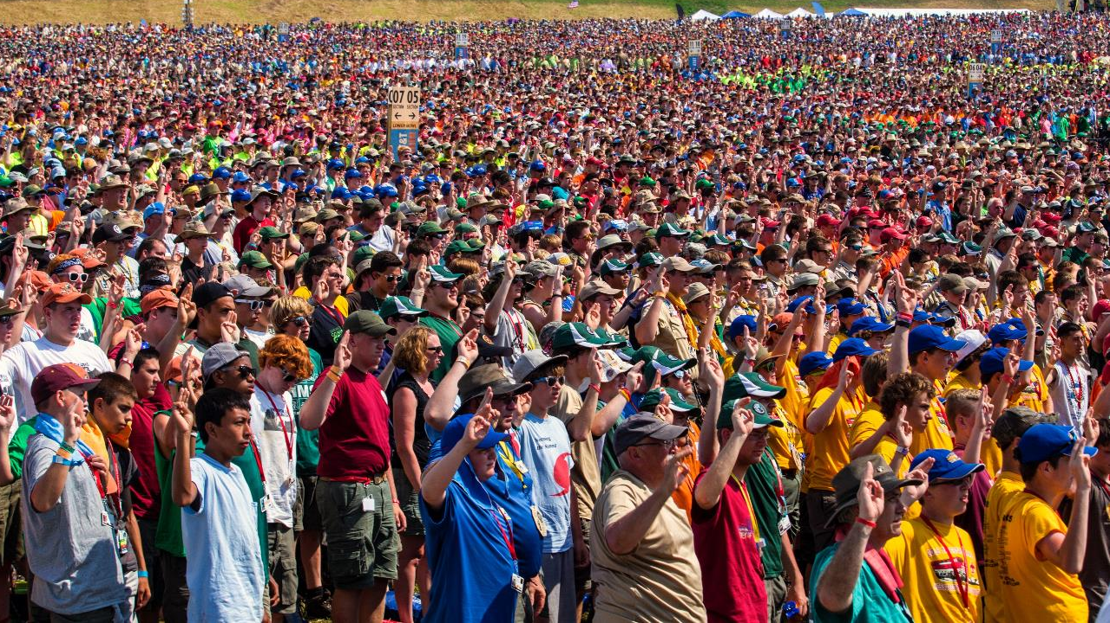
SCOUT OATH
On my honor I will do my best to do my duty to God
and my country and to obey the Scout Law;
to help other people at all times;
to keep myself physically strong,
mentally awake, and morally straight.
Notes:
Another great message to reinforce with parents and kids. We live and breathe the Scout Oath every day. It is a wonderful message and one we should reinforce with potential new members because who doesn’t want their child to learn these things? Explain to them when and it is said but, more importantly, why it is so important.

Slide 10
SCOUT LAW
A Scout is…
Trustworthy, Loyal, Helpful, Friendly, Courteous, Kind,
Obedient, Cheerful, Thrifty, Brave, Clean, Reverent.
Notes:
The third and final foundational element of who we are as the BSA. It is important to let parents know that these are the values we will help their children develop as members of our program. Our method works and has worked for over a century and it will work for their children too.

Slide 11
AIMS & METHODS OF SCOUTING
Notes:
The guiding principles are fantastic, but how do we achieve this? Through the aims and methods of Scouting.

Slide 13
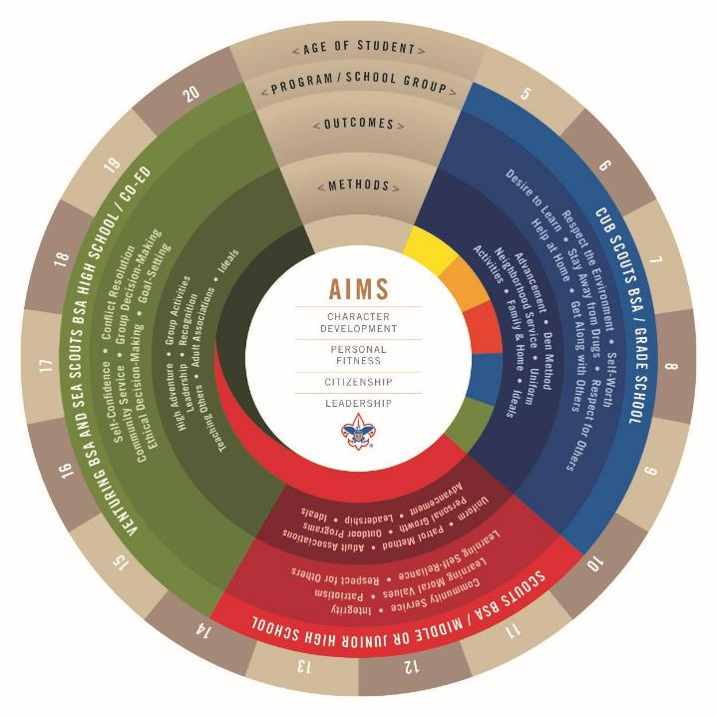
SLIDE SUB-TITLE
SLIDE SUB-TITLE
Notes:
Parents of current Scouts may know this and may have even seen this graphic. The point isn’t to go through each detail, but rather to show them that along each step in the Scouting program, there are specific tactics to help their children succeed in achieving the four aims of Scouting

Slide 14
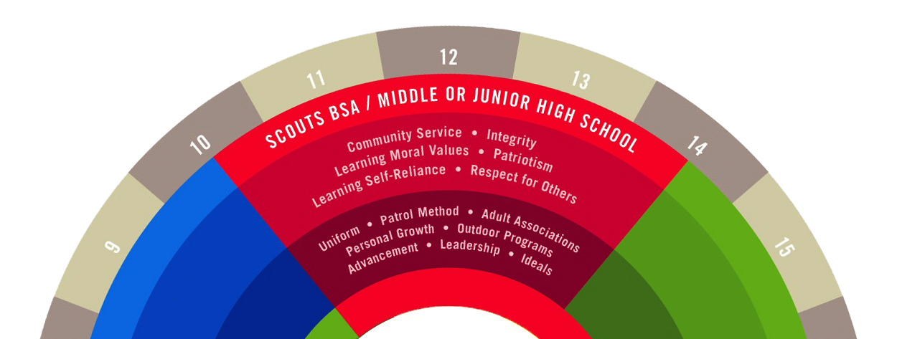
SCOUTS BSA - AIMS OF SCOUTING
SLIDE SUB-TITLE
Notes:
Specifically for members of the Scouts BSA program, we will work to instill a desire to serve the community, develop personal integrity, teach moral values, develop a sense of patriotism, teach self-reliance and respect for others. We achieve this by emphasizing the importance of the uniform, patrol method, adult association, personal growth, outdoor programs, advancement, leadership development, and ideals.

Slide 15
WHAT IS THE PATROL METHOD?
SLIDE SUB-TITLE
OVERVIEW
Simply put, the patrol method is Scouting’s way of developing young leaders by creating multiple opportunities for Scouts to play a role in the leadership of a troop.
Notes:
This is another important detail for new parents and members, many of whom want their child to learn leadership skills. Here’s your chance to explain it. Provide examples of patrols in your own troop. What do they do? How does this help youth develop? Why do you think it’s important?

Slide 16
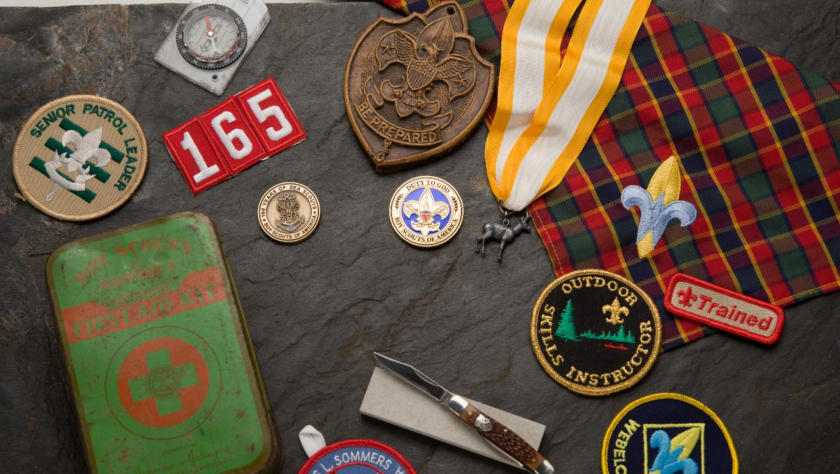
“None of us is as good as all of us”
Ray Kroc

Slide 17
LET’S TALK ABOUT ADVANCEMENT
Notes:
This is why we’re all here, so lead with this. Keep it simple.

Slide 18
WHY IS THIS IMPORTANT?
SLIDE SUB-TITLE
ADVANCEMENT
Advancement plays a vital role in youth development in the Scouts BSA program.
It provides:
Structure
Goal setting
Tracking
Achievement
Notes:
Advancement is one of the most important elements of the “secret sauce of Scouting”. It provides Scouts a clear set of rules, allows them to set goals, track their progress, and ultimately achieve new ranks. This is vital to the success of young men and women both in Scouting and in their professional lives and it helps them prepare for the next big phases of life.

Slide 19
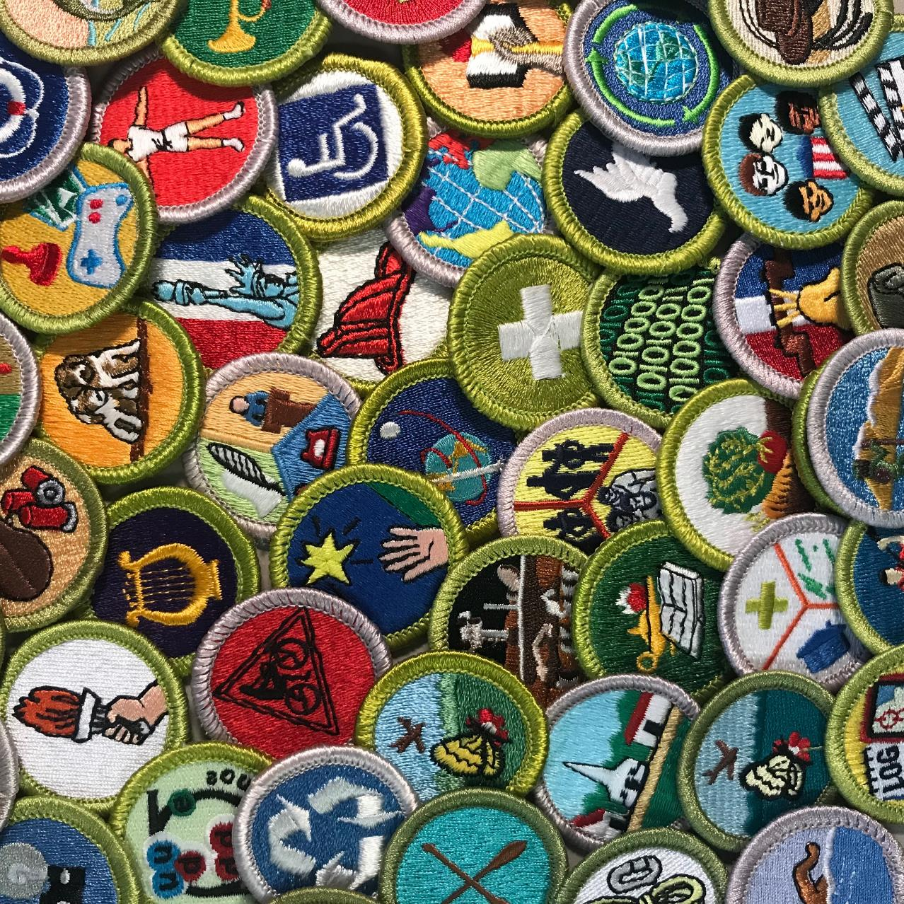
IT’S NOT ALL ABOUT RANKS THOUGH…
In Scouts BSA, there’s something for everyone!

Slide 20
MERIT BADGES
SLIDE SUB-TITLE
ADVANCEMENT
There are 137 merit badges across practically any field of study where your child can explore the world and find their passions. Some of the most popular merit badges include:
Citizenship to the World
Environmental Science
First Aid
Swimming
Cooking
Notes:
Merit badges are another element of the ”secret sauce” of Scouting. How many times have you talked to a Scout who said “If it hadn’t been for my time in the BSA, I never would have found my passion for _______.” In Scouting, there truly is something for everyone and it’s up the the kids to determine what that something is. They may find a passion they never would have thought of had it not been for Scouting.

Slide 21
ENOUGH ABOUT THE BSA,
LET’S TALK ABOUT OUR TROOP!
Notes:
Now that we’ve covered the big picture about Scouts BSA, how it works, etc. now it’s your time to shine and share the fun things about your own troop.

Slide 22
TROOP ____
SLIDE SUB-TITLE
OVERVIEW
Insert details here about your troop. Who are you? What are you good at? What are you known for?

Slide 23
TROOP (XXX) STRUCTURE
SLIDE SUB-TITLE
OVERVIEW
COMMITTEE CHAIR
SCOUTMASTER
SENIOR PATROL LEADER
ASS’T SCOUTMASTER
SECRETARY
TREASURER
TRAINING
ADVANCEMENTS
TROOP
MEMBERSHIP
ACTIVITIES
FUNDRAISING
EQUIPMENT
WEBMASTER
(OTHER)
LIFE TO EAGLE
(OTHER)
THE COMMITTEE
Notes:
Start big picture and work your way down. Even for Cub parents, this is important as they may not understand how/why it is different from the Cub Scout model. Don’t worry about getting into what every position does, that will come in due time. Don’t scare them off with information overload! Also, feel free to customize this chart. Not every troop will be structured exactly the same, so make this work for you.

Slide 24
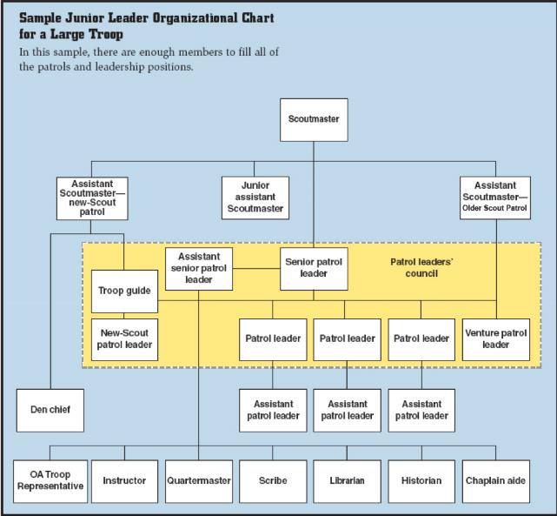
TROOP LEADERSHIP
SLIDE SUB-TITLE
OVERVIEW
Notes:
Once again, great to provide an overview, but don’t bother getting into the minutiae of what every position does. A simple overview and a reminder that “your child will have the opportunity to have a leadership role and develop as time goes on” will suffice.

Slide 25
ADULT VOLUNTEERS
SLIDE SUB-TITLE
OVERVIEW
Volunteers are vital to the success of any Scouts BSA troop and the Scouts they serve. It is an incredible experience to share with your child and one that will make memories that will last a lifetime.

Slide 26
SO, WHAT DO WE DO?
Notes:
Now is your chance to review both your annual schedule to give parents an idea of what you do and when as well as reviewing a sample weekly schedule.

Slide 27
WEEKLY MEETINGS
SLIDE SUB-TITLE
LOOKING AHEAD
We meet every (X) at (X) from (X) – (X)
TIME | ACTIVITIES
7:00 – 7:15 | Insert details
7:15 – 7:45 | Insert details
7:45 – 8:15 | Insert details
8:15 – 8:45 | Insert details
8:45 – 9:00 | Insert details
Notes:
When and where do you meet? What does a typical meeting look like? Keep it simple, all you’re trying to do is set the stage for how this all works.

Slide 28
2019 SCHEDULE
SLIDE SUB-TITLE
LOOKING AHEAD
MONTH | ACTIVITIES
JANUARY | Insert details
FEBRUARY | Insert details
MARCH | Insert details
APRIL | Insert details
MAY | Insert details
JUNE | Insert details
JULY | Insert details
AUGUST | Insert details
SEPTEMBER | Insert details
OCTOBER | Insert details
NOVEMBER | Insert details
DECEMBER | Insert details
Notes:
Fill in activities to set the stage for what major events are coming up, especially big trips.

Slide 29
LET’S TALK ABOUT COSTS
Notes:
This is why we’re all here, so lead with this. Keep it simple.

Slide 30
COSTS
SLIDE SUB-TITLE
OVERVIEW
Insert information about costs here. Whatever you do, make sure this is the last slide in the deck. Until now, everything should be about the child.
NO ONE WANTS TO SEE THIS FIRST.
Notes:
This is the elephant in the room. It’s important, but needs to be the last thing they see. Think about it like a sale. We want to hook them in first and not scare anyone away with the costs, low as they may be. The point is all about fun, so keep this slide until the very end.

Slide 31
QUESTIONS?

Slide 32
WELCOME TO SCOUTS BSA!

